Slide 1
Use Cases
Carsten Hufe Senior Data Engineer
September 2017

Slide 2
Use Cases
BI / ETL offload
MapR Converged Data Platform for Docker
MapR-Streams to scale OPC connections
MapR Edge for IT architectures

Slide 3
BI / ETL offload

Slide 4
Data Warehouse
Offload/Optimization Motivating Factors

Slide 5
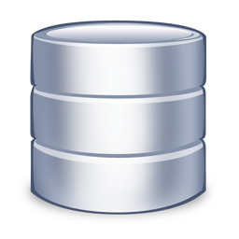
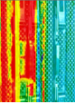



Challenges With Traditional Data Warehouses
Unused Data,
Related Loads
EDW
Exorbitant costs, inability to scale
Almost 60% of CPU capacity is ETL
70+% of data is unused or infrequently accessed
15% of CPU is consumed by ETL that loads unused/infrequently-accessed data
Does not support modern analytics technologies
ELT
Unused
Tables
(72%)
ELT
Source: Appfluent
Notes:
The enterprise systems pressure may be high, but there is a surprisingly low amount of scrutiny to what data and workloads make it into the data warehouse…and stay there. Consistently, large corporations, when their data warehouses are analyzed, assessed or audited, find that most of their data has not been queried analytically in the last year. They find a huge amount of data transformation work has been ‘pushed down’ to run on the data warehouse, even though the premise of data warehouse was to support analytics, not data management. As a result, these companies end up having to expand data warehouses relentlessly year after year when they run out of CPU for the transformations and data space.

Slide 6
Forces of Adoption
MapR can significantly reduce cost compared to enterprise data warehouse, DBMS and storage
IT BUDGETS GROWING AT 2.4%
DATA GROWING AT 40%
$ PER TERABYTE
Data
IT Budget
ENTERPRISE STORAGE
DATABASE WAREHOUSE
Gartner IT Spending, Worldwide, 4Q14 Update
IDC Digital Universe study, “Extracting Value from Chaos”
Notes:
Need a Platform that serves the broadest sets of use cases…
IDC says that in 2011 we created 1.8 zettabytes (or 1.8 trillion GBs) of information. In 2012 it reached 2.8 zettabytes and IDC now forecasts that we will generate 40 zettabytes (ZB) by 2020.
http://www.webopedia.com/quick_ref/just-how-much-data-is-out-there.html

Slide 7
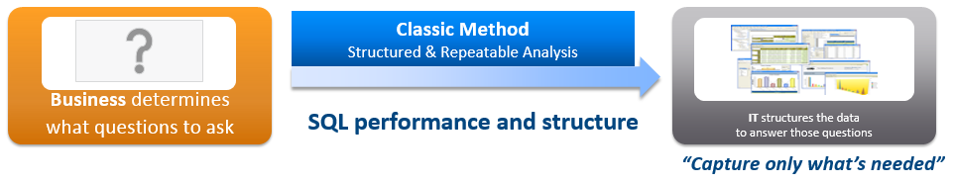

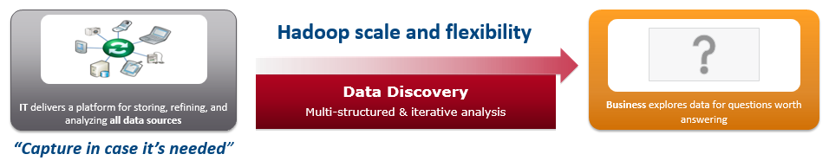
A Better Way to Enable BI and Analytics
Business determines what questions to ask
EDW
Business explores data for questions worth answering
Data Lake

Slide 8
Benefits of Data Warehouse Offload & Optimization
Augment and extend the life of current data warehousing assets
Increase available “headroom” and avoid or minimize new cap ex
Sharply reduce the total cost of data management and analytics
Gain vital business benefits via superior Next Generation business analytics
Use tools unavailable in legacy data warehousing (Drill, Parquet, Spark, Machine Learning, others)
Tap new data that can’t be sourced or economically stored in the legacy data warehouse (sensors, logs, history, others)
Sharply reduce the “cost of asking new questions” with greater speed and frequency of “time to insight”
Enable broader, longer-term Next Generation IT strategies and goals

Slide 9
DW Offload

Slide 10
Identifying the Right Data & Workloads
Perform holistic analysis of all data and workloads to identify:
Unused and rarely-used data
Expensive ETL workloads
Costly loops and validation steps
Not all workload migrations have equal payback
Identify those that will deliver the biggest impact for the initiative
20/80 rule: 20% of data transformations can consume up to 80% of resources
Queries/workloads to flag: high CPU consumption
Data to flag: high disk consumption and/or infrequent access
Notes:
Pareto principle

Slide 11



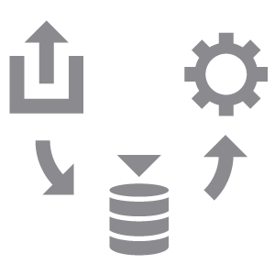

Enterprise Data Warehouse Offload/Optimization
DWO - Move Selected Historic/Cold Data to MapR
One-time offload of historic, rarely-accessed data
Minimal impact to existing data pipelines
Restores storage capacity to EDW
DWO - Move Selected ETL to MapR
Present new data for exploration
ETL work includes incremental updates
Restores CPU and storage capacity to EDW

Slide 12
DWO Categories/Approaches
Automated offload of historical/cold data
Copy/move target data from EDW to MapR cluster
Usually possible to automate recurring data migration processes
Semi-automated offload of selected ETL
May require moderate-to-substantial rework of ETL processing logic
Example workloads:
Simple aggregation
OLAP aggregation for clustered & non-clustered columns
Simple join & multi-table joins
Built-In User Defined Functions (UDFs) and/or custom UDFs
Some like-to-like code conversions
Notes:
OLAP = Online analytical processing

Slide 13
DWO Categories/Approaches (cont.)
Modernized Data Architecture
Architect all workloads from scratch to use appropriate processing engines
Leverage cost-efficient platform to seamlessly collect, prepare, blend, transform & distribute data
Prepare data for analytics
Blend data for new insights
Transform data with “design once & deploy anywhere” approach
Pre-process data to sort, cleanse, and filter data before publishing to subscribers
Apply MapR-DB, MapR Streams, Drill, Spark, and custom scripts as appropriate
Automation: Modernized workload with new features
Notes:
----- Meeting Notes (4/18/16 12:00) -----
what you do is ELT, then analytics
in hadoop, requires export
have to show data going back to TD

Slide 14
Tools for Offload

Slide 15
Tools for Offload
Notes:
----- Meeting Notes (4/18/16 12:00) -----
what you do is ELT, then analytics
in hadoop, requires export
have to show data going back to TD

Slide 16
Components for Analysis

Slide 17
Components for Analysis
Notes:
----- Meeting Notes (4/18/16 12:00) -----
what you do is ELT, then analytics
in hadoop, requires export
have to show data going back to TD

Slide 18
Data Formats
Notes:
Short walkthrough of different data formats

Slide 19
Data Formats
Files formats
CSV / TSV
JSON
Sequence files
Avro
Parquet
Databases
MapR-DB binary
MapR-DB JSON
Notes:
“It’s not a complete list, only most important”

Slide 20
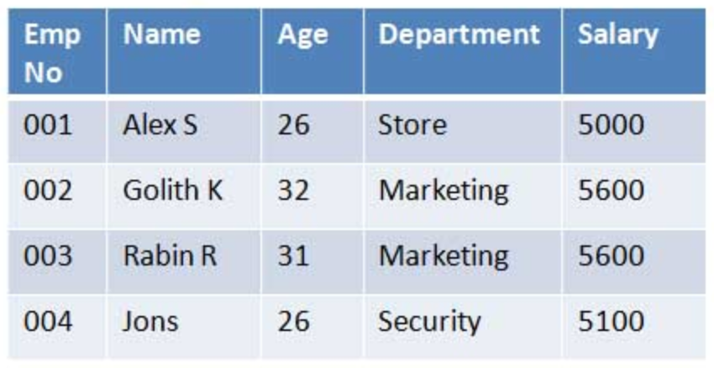
Rows vs. Columns

Slide 21
Rows vs. Columns
Row oriented | Column oriented
Dataset “row” is always read completely. No join required, but unnecessary data can be read Choose when there are just a few columns available or all columns are always queried. | Only columns are read, which are part of query. Values of same row needs to be joined. Good compression ratio, because of high chance of repeating values. Choose when many columns are available and only small subset is queried.
Notes:
----- Meeting Notes (4/18/16 12:00) -----
what you do is ELT, then analytics
in hadoop, requires export
have to show data going back to TD

Slide 22
CSV / TSV
Text separated by characters
Convenient and simple format to use to exchange with other applications or scripts that produce or read delimited files
Human readable and parsable
Data format is bulky and not that efficient to query
No built-in block compression
Notes:
----- Meeting Notes (4/18/16 12:00) -----
what you do is ELT, then analytics
in hadoop, requires export
have to show data going back to TD

Slide 23
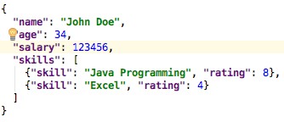
JSON
Text as a document
Human readable and parsable
No built-in block compression
Embedded, “sub documents” are possible
Notes:
----- Meeting Notes (4/18/16 12:00) -----
what you do is ELT, then analytics
in hadoop, requires export
have to show data going back to TD

Slide 24
Avro
Widely used as a serialization platform
Row-based, offers compact and fast binary format
Schema is encoded on the file so the data can be untagged
Files support block compression and are splittable
Supports schema evaluation
Notes:
----- Meeting Notes (4/18/16 12:00) -----
what you do is ELT, then analytics
in hadoop, requires export
have to show data going back to TD

Slide 25
Parquet
Column-oriented binary file format
Uses the record shredding and assembly algorithm
Each data file contains the values for a set of rows
Very efficient in terms of disk I/O when specific columns need to be queried
Block compression embedded
Notes:
----- Meeting Notes (4/18/16 12:00) -----
what you do is ELT, then analytics
in hadoop, requires export
have to show data going back to TD

Slide 26
MapR-DB binary
HBase compliant API
Organized in column families, columns and rows
Optimal for range scans and random access
Single datasets can be updated or deleted
No major compactions required as in HBase
Supports embedded compression based on column families
Can be connected using Drill
Notes:
----- Meeting Notes (4/18/16 12:00) -----
what you do is ELT, then analytics
in hadoop, requires export
have to show data going back to TD

Slide 27
Column Family
Columns in same CF will be read together
Notes:
----- Meeting Notes (4/18/16 12:00) -----
what you do is ELT, then analytics
in hadoop, requires export
have to show data going back to TD

Slide 28
MapR-DB JSON
MapR’s OJAI API to access data with Java applications
Organized with JSON-style documents which get stored in a binary format in MapR-DB
Optimal for range scan and random access, with MapR 6.0 secondary indexes will be supported
Single datasets can be updated or deleted
Supports embedded compression
Can be connected using Drill
Fields can be segregated using field patterns to store data in column families
Notes:
----- Meeting Notes (4/18/16 12:00) -----
what you do is ELT, then analytics
in hadoop, requires export
have to show data going back to TD

Slide 29
Rows vs. Columns
Row oriented | Column oriented
CSV / TSV / Text JSON “Documents” but row oriented. Sequence files Avro | Parquet MapR-DB binary MapR-DB JSON
Notes:
----- Meeting Notes (4/18/16 12:00) -----
what you do is ELT, then analytics
in hadoop, requires export
have to show data going back to TD

Slide 30
Files vs. MapR-DB
Files | MapR-DB
Good for batch processing and full scans Partitioning with directories Full files need to be updated, when using batch processing | Optimized for range scans or random access, full scan also works Update of single records
All can be used to process using Spark, Drill, MapReduce, Java APIs.
Notes:
----- Meeting Notes (4/18/16 12:00) -----
what you do is ELT, then analytics
in hadoop, requires export
have to show data going back to TD

Slide 31
Case Studies

Slide 32
DWO Case Study 1 Healthcare Client Automated Approach

Slide 33
Limited Data and High Costs Drove the Change
Limited Data
Costly Tools
ETL
ELT
Before
After
ETL &
Data Exploration

Slide 34
Operational Challenges Faced by the Customer
Large number of datasets
Normal job ran overnight
Over 10,000 different tables to import into the cluster
Frequent issues: connections drops, had to restart the job to produce reliable data
Looking to build automated framework

Slide 35
Automated Framework Developed by MapR
Main Parallel Script
Sqoop-based main script that initiates, manages and executes in parallel all other component scripts
Data Ingest Component
Source-Destination
Component
Publish
Component
Notification
Component
Ingests data and metadata into Hadoop from RDBMS
Script to validate and verify the ingested data on Hadoop
Source to Target copy and validation script
Creates and sends an email about the result of the run/execution
Notes:
Have the RDBMS/Hadoop connectors on the node configured and ready
Use the RDBMS native tools and/or sqoop with import tool configuration scripts to copy tables to source/destination
Move resulting files to hive directory
Create external hive tables
Port sql to HQL and Pig Scripts without changing business and processing logic.
This framework can be modified and developed in an elaborate manner for automation and reporting based on clients needs and requirement.
The framework runs every Hadoop ecosystem component (hive, sqoop, pig) in it’s own managed loop, so if the operation fails it will be re-attempted $NO_OF_TRIES times.
Also in between the tries the framework will pause for the $SLEEP_INTERVAL seconds.
Please set up these parameters carefully and accordingly.
Also, as per design - the failure to load specific table (if all $NO_OF_TRIES failed) does not stop the framework immediately
ANYMORE but logs the error(attempt) and continues to the next table.
So this way all successfully loaded tables will be published and although the total status of the run will result in failure, it will be needed to re-run only failed tables in the next attempt (after determining the reasons of the failures, based of the extended-info log files).

Slide 36



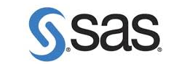


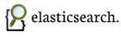
High Level ETL Ecosystem
Data Movement
Operational Apps, Member 360, Call Center
Data Access
Data Sources
Analytic Node Count
Non-Prod | Prod
24 | 48
Operational Node Count
Non-Prod | Prod
8 | 16
CSV
TSV
NDB
Text data
Proprietary Data
… and more.
Visualization
Sqoop, NFS
Hive, Pig
Drill
Spark Streaming, Mahout, MLLib, SparkSQL
MapR-DB / NoSQL,
Search
Analytics
Ingest, ETL, Batch Processing
Interactive SQL
Real-time Processing
Operational
MAPR DISTRIBUTION FOR HADOOP
MapR-FS
MapR Data Platform
NFS
MapR-FS
MapR-DB
HBase API
Search

Slide 37
Operational Metrics
Approximate benchmark time to move data across Teradata to Hadoop
~ 3 hours per load of 1500 RDBMS tables (average # of rows in the 10s of millions)
Sqoop/Hive/Hadoop FS Copy
Metadata layer built in Hive
What kind of hardware
48 nodes, 48 x 4 x Quad cores
96 GB Per node
RedHat OS 6.7.X
How much work was involved?
~ 4 months to build and automate the framework on an ongoing basis
~ 2 weeks to adopt a new workload
What was the ROI?
Lower cost storage (Hadoop vs. Teradata)
Reduced cycle times
Alternative, powerful tools for data loading and manipulation

Slide 38
Automation Driven by Configuration File
Usage: MainParallel.sh <Configuration_file> <Number_of_scripts>
<Configuration_file>
The purpose of the Configuration file is to define:
- all necessary specific parameters needed for the run
- definitions of N-numbered CONN_NAME - connections to the RDBMS
- definitions of N-numbered TABLES - tables to be imported into the Hadoop from the RDBMS
- definitions of N-numbered PUBLISHTBL - tables to be copied to the targeted destination
<Number_of_scripts>
Defines how many groups will be run (all groups of tables will be run in parallel with all other groups.
Example:
<Framework-Dir>/MainParallel.sh ./Conf-simple.sh 4
This will run 4 parallel executions
- 1st execution: CONN_NAME1, TABLES1, PUBLISHTBL1
- 2nd execution: CONN_NAME2, TABLES2, PUBLISHTBL2
- 3rd execution: CONN_NAME3, TABLES3, PUBLISHTBL3
- 4th execution: CONN_NAME4, TABLES4, PUBLISHTBL4

Slide 39
Sample Configuration File
export SOURCESYSTEM=PCP
export PI_RPT_DNS=maprfs:///mapr/datalake_test
export MAPR_DIR=/mapr
export PI_RPT_ROOTDIR=/datalake/???/ei/pi_reporting
export PI_ARA_DNS=maprfs:///mapr/datalake_test
export PI_ARA_DEST_DIR=$PI_ARA_DNS${PI_RPT_ROOTDIR}/tempdatadev/data_sources/Lab/PCP
export LOG_DIR=${MAPR_DIR}${PI_RPT_ROOTDIR}/users/VADIM/VB_LOGS
export HIVEDB=vb2
export TARGET_DIR=${PI_RPT_DNS}${PI_RPT_ROOTDIR}/users/VADIM/VB_DATA2
export HADOOP_OPTS="-Dmapreduce.job.queuename=piaadmin_q1"
export JOB_QUEUE=${HADOOP_OPTS}
export NO_OF_TRIES=5
export SLEEP_INTERVAL=0
export CONN_NAME1="IOM_PCP_Facets"
export CONN_NAME2="IOM_PCP_Facets"
export CONN_NAME3="IOM_PCP_Facets"
export TABLES1=“CMC_CMCM_CASE_MGT CMC_NWNW_NETWORK CDS_CLHC_TEMP"
export TABLES2="CDS_TEMP_CUST_CMP CDS_TEMP_CUST_CAS CDS_TEMP_CUST_CDS"
export TABLES3="CUS_AUTOA_CODEMASTER"
export PUBLISHTBL1=“CMC_CMCM_CASE_MGT CMC_NWNW_NETWORK"
export PUBLISHTBL2="CDS_TEMP_CUST_CMP CDS_TEMP_CUST_CAS CDS_TEMP_CUST_CDS"
export PUBLISHTBL3="CUS_AUTOA_CODEMASTER"

Slide 40
DWO Case Study 2 Oil and Gas Client Semi-Automated Approach

Slide 41
What’s the Difference
Similar to Automated approach
Leverage automation to migrate workflow onto Hadoop
Expected high success rate of migration
Manually address complex elements
Custom UDFs
Data type formats
Change data capture logic
Massive joins
Distinct/unique
On disk data format and location (ORC, Rcfile, sequencefile, partition)

Slide 42
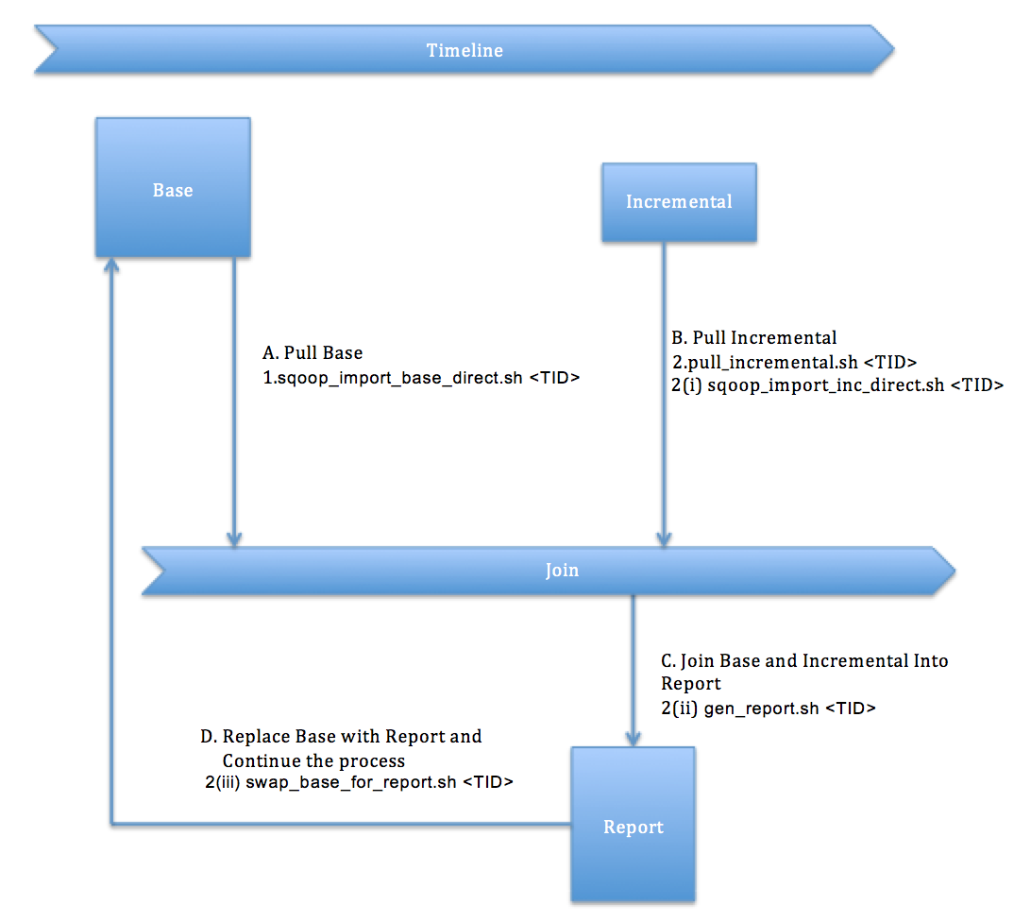
Workflow Process
Notes:
Customer was looking to offload data to distributed environment and progressively process the transformation using appropriate compute engine
Sqoop was used to pull base and incremental data from Oracle into the MapR FS.
Data was stored as Parquet file due to the flexibility it offers for processing using many Hadoop EcoSystem tools.
Spark was used to retrieve the latest record timestamp from base, merge the data and create unique ID’s from composite keys for tables which needed them.
Bash was used to build the workflow scripts.
Crontab was used for scheduling workflows.

Slide 43
Workflow Steps
sqoop_import_base_direct.sh <TID>
pull stable data up to script execution timestamp from table defined in the script
use spassword stored in MapR FS, under /user/mapr/<TABLE>_password.txt
currently uses the Oracle Direct connector (can be modified to pull without the connector)
saves to /offload/<TABLE>/<TID>_base_direct in Parquet format
pull_incremental.sh <TID>, executes in three steps following:
merges base pull with incremental pull, creating the reporting table
filters out all incremental ID’s from base table
coalesces base table to 540 partitions in order to prevent file sprawl
saves base to /offload/<TABLE>/<TID>_report_direct/modified=0 in Parquet format
saves incremental to /offload/<TABLE>/<TID>_report_direct/modified=1 in Parquet format
swap_base_for_report.sh <TID>
deletes old base
deletes old incremental
renames report to base

Slide 44
Data On Disk Layout
An offload base volume was created and mounted at /offload
A volume was created in MCS for each table needing to be pulled (IE: headers, resolution_log, rules_tripped) and was mounted under /offload
The volumes were created in the /data topology and were configured with replication 3 and minimum replication 2
Volume creation can easily be scripted via maprcli:
create -name "<TABLE>"-path /offload/<TABLE> -replication 3 -
minreplication 2 -topology /data -type rw
Nightly snapshots were configured for the “headers” volume. Snapshot recovery was tested with a sample file copy out of the .snapshot directory

Slide 45
DWO Case Study 3 Telecom Client Modernized Data Architecture

Slide 46
What’s the Difference
Goes well beyond Automated and Semi-Automated approaches
Modernize workflows using Hadoop
New patterns of ingestion
New processing engines
Low latency BI
Leverage NoSQL
Etc …

Slide 47
How Is It Accomplished
Start with the end in mind
Identify the source(s)
Map existing data source to end points
This represents a use case footprint including:
All data
Transformation
Aggregation
Access patterns
Modernize the workflow using Hadoop

Slide 48

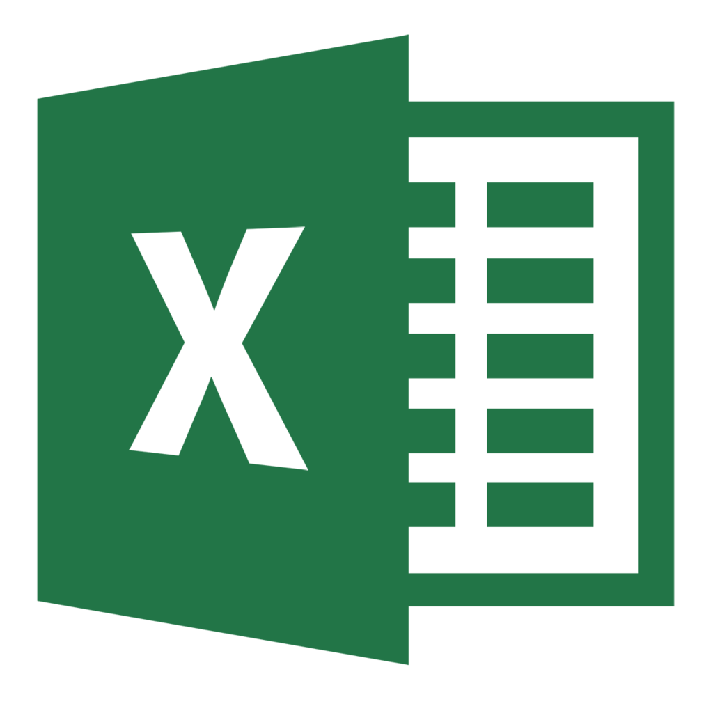




Big Data Workflow (ETL) On MapR
Data Sources
Visualization
Clickstream
Processing and Analytics
Sensor Data
Access
Ingest
Billing Data
HBase
MapReduce
MapR-DB
Pig
NFS
Product Catalog
Pig
Cascading
Storm
Tez
Sqoop
CRM / ERP
Oozie
Hive
MLLib
Drill
Flume
Social Media
Hive
HDFS
Solr
YARN
Mahout
Server Logs
Impala
Merchant Listings
MapR Data Platform
Online Chat
Call Detail Records

Slide 49
Use Case Data Flow Example
Data Sources
Visualization
Clickstream
Processing and Analytics
Set-Top Box Data
Access
Ingest
Billing Data
HBase
MapReduce
MapR-DB
Pig
NFS
Product Catalog
Pig
Cascading
Storm
Tez
Sqoop
Mobile Data
Oozie
Hive
MLLib
Drill
Flume
Social Media
Hive
HDFS
Solr
YARN
Mahout
Server Logs
Impala
Merchant Listings
MapR Data Platform
Online Chat
Call Detail Records

Slide 50
Publish & Secure Ensuring Enterprise-Readiness
Define best practices and policy adoptions
Ensure only authorized users/applications are able to subscribe to your data
Prepared data consumed by DW
Secure data on disk from unauthorized access using Access Control Expressions
Coarse Grain Volume controls
Fine Grain Table and File controls
Information life-cycle management process implementation
Enable data access policies for user, groups, administrator
Volume layout for data on disk
Multi-structured access and spanning several months and years
Data archival
Storage for data that has completed lifecycle
Long term storage of infrequently used data
Continue to analyze long-term history on cost efficient platform

Slide 51
Teradata-Specific
DWO Considerations

Slide 52
Important Tools & Technologies for Teradata DWO
Tools/technologies to assess costly queries & workloads
Database Query Log (DBQL), Performance Data Collection and Reporting (PDCR)
Especially helpful for determining queries/workloads that consume the most CPU
Query bands: can help assess the impact of various categories/types of queries (e.g., ETL/ELT workloads, BI tools)
Tools to facilitate data transfer between Teradata and MapR
FastExport, Teradata Parallel Transporter (TPT), BTEQ
Teradata Connector for Hadoop (TDCH)
JDBC/ODBC

Slide 53
Other Important Considerations
Teradata is built on a highly scalable, shared-nothing architecture, with a very robust query optimizer
As a result, some analytical queries might be best left on Teradata
Highly complex multi-table joins
Low latency, tactical queries (<100ms) with a large user population
The tradeoff, of course, is the high cost of the underlying hardware
Other workloads are probably better suited for MapR
ETL/ELT (unless the embedded business logic is very complex)
Real time operational analytics
Unstructured data (“schema on read”)
End-user retraining/acceptance may be the largest “hidden” cost
Where possible, build solutions using tools they’re already familiar with

Slide 54
Hands-on

Slide 55
Hands-on
Continue in 10 mins
(Coffee break)

Slide 56
DB schema
Question:
What is the average salary based on title
and gender?

Slide 57
Demo
Load data
Write as
JSON to MapR-FS
JDBC with RazorSQL
ODBC with Tableau

Slide 58
Appendix

Slide 59
Offload Cold Data to Hadoop
Log Archive
Data Warehouse
Process:
One-time Migration of Cold Data
Demonstration of Data upload to DW
Data Access:
ODBC
Thrift
Standard Connectors
Structured Data
Incoming Data
ETL
Cold Data Offload
MapR Data Platform

Slide 60
Offload ETL onto Hadoop
Data Warehouse
Process:
One-time Migration of Historical Data
Redirection on New Data
Migration of ETL onto Hadoop
Demonstration of Data upload to DW
Data Access:
ODBC
Thrift
Standard Connectors
Low Latency Data
Restored CPU and Disk
Incoming Data
Bulk Data
ETL
MapR

Slide 61
MapR Converged Data Platform For Docker

Slide 62
Announcement
MapR Announces the Converged Data Platform for Docker
Supports containerization of existing
and new applications by providing containers with
persistent data access from anywhere

Slide 63
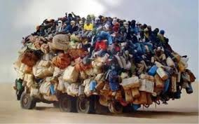
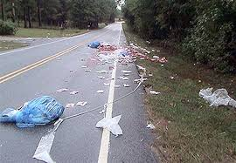
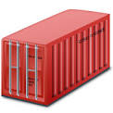
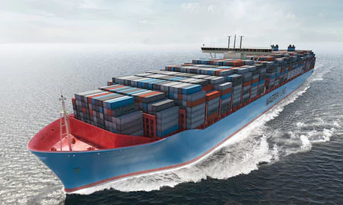
Container Benefits – Physical World
World Without Containers
World With Containers
Load
Hope
Pack
Ship
Without containers, goods are loaded ad-hoc and may not reach their final destination.
With containers, goods are packed in a more consistent way, greatly improving portability and minimizing the chance of loss.

Slide 64
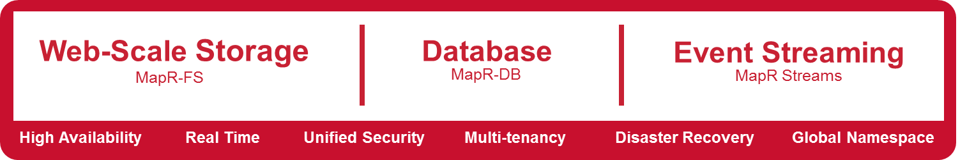
Leverage on-premises and/or cloud
App Container
Deploy existing stateful apps in containers on any node
No special configuration for nodes
Data access is built into containers
App Container
App Container
App Container
App Container
App Container
…
MapR Converged Data Platform

Slide 65







Container Benefits – Virtual World
World Without Docker
World With Docker
3. Provision stuff
System
Admin
On Prem
1. My app is done. Can you deploy it?
1. My containerized app is done. Can you deploy it?
3. Provision stuff
2. Deploy
Anywhere
2. Sure, give me two weeks.
3. Done.
Developer
IT Admin
Storage
Admin
Developer
IT Admin
Public Cloud
5. It didn’t work. Can you
try again?
3. Provision stuff
4. Something didn’t work!
Network
Admin
Private Cloud

Slide 66



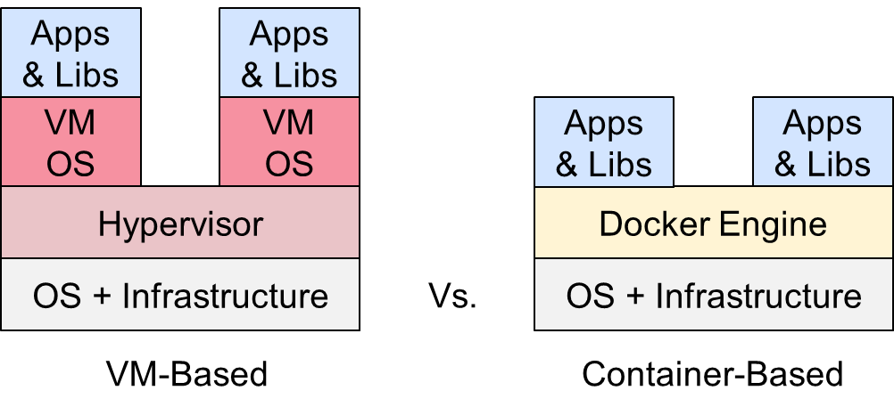


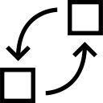
Containerization – Additional Benefits
Data Center Virtualization (Private Cloud)
Repeatability
Improved Hardware
Utilization
Testability
1010101001001 10001000100101101001010100101001010101010101100
More Efficient than VM-Based Virtualization
Fault Tolerance
Scalability /
Elasticity
Portability

Slide 67

MapR Persistent Application Client Container (PACC)
Pre-built, certified container image for connecting to MapR services
Secure authentication at container level, secure connection
Extensible support for application layers
Available in Docker Hub, Dockerfile for customizability
MapR PACC
Space for Customer Application
MapR POSIX Client for Containers
MapR Converged Client for Containers
1010101001001 10001000100101101001010100101001010101010101100

Slide 68
Leverage on-premises and/or cloud
App Container
Deploy existing stateful apps in containers on any node
No special configuration for nodes
Data access is built into containers
App Container
App Container
App Container
App Container
App Container
…
MapR Converged Data Platform

Slide 69
Two Deployment Options
App Container
App Container
App Container
App Container
1
2
1010101001001 10001000100101101001010100101001010101010101100
Deploy containers on
MapR nodes
Deploy containers remote client nodes

Slide 70
Three Connection Options
App Container
App Container
App Container
App Container
NFS Client
POSIX Client
2
1
Deploy containers on nodes with standard NFS client
Deploy containers on nodes with MapR POSIX Client
1010101001001 10001000100101101001010100101001010101010101100
App Container
App Container
PACCs
Preferred
Approach
3
Deploy containers on any node, using PACC

Slide 71
Three Use Cases

Slide 72

Use Case #1 - Containerizing an Existing App
Solution: MapR PACC allows existing applications to store state in MapR Converged Data Platform, ensuring resilience and availability across application and infrastructure failures.
Container Environment (Mesos, Kubernetes, Swarm)
Advantages
Containers can survive application or hardware failures by restarting and accessing data
Containers can move across data centers using MapR data replication capability
Example Apps
RDBMS (MySQL, Postgres, Vertica, SAP)
Source control (Git, Mercurial)
1010101001001 10001000100101101001010100101001010101010101100
MapR Cluster
Reliable, Persistent, High-throughput Storage
MariaDB Volume
Logs Volume

Slide 73



Use Case #2 - Shared Storage for App & Analytics
Solution: MapR PACC allows applications to persist data to a secure,
shared location where other applications (like analytics) can access it.
Container Environment (Mesos, Kubernetes, Swarm)
Advantages
Shared data repository for multiple apps, operations & analytics
Decoupled scaling of compute & storage
Example Apps
Rapid-ingest Logging (Impressions, Clicks)
Image Store (Thumbnails, High Res)
1010101001001 10001000100101101001010100101001010101010101100
MapR Cluster
MariaDB Volume
Logs Volume
Reliable, Persistent, High-throughput Storage

Slide 74

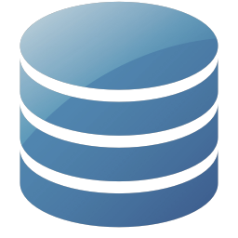
Use Case #3 - Microservices
Solution: MapR + PACC provides complete suite of reliable,
scalable data services to microservice applications.
Advantages
Efficiency: data services are offered by the platform, not deployed ad-hoc by developers
Scale, reliability inherited by all apps
Use Cases
Stateful microservices
Inter-microservice Communication
Per-microservice database
Container Environment (Mesos, Kubernetes, Swarm)
1010101001001 10001000100101101001010100101001010101010101100
MapR Cluster
Reliable, Persistent, High-throughput Storage
MapR-FS

Slide 75

Base Architecture Assumption
MapR Data Platform is the Basis of the Architecture
All MapR Storage Features: Distributed R/W, NFS/POSIX Client, Auditing, Mirrors (Immutable & Consistent), Snapshots (Immutable & Consistent), Compression, Access Control (ACEs), Authentication & Authorization for Data Access
MapR-DB, MapR-DB JSON and MapR Streams are Available to All Applications
NFS/Fuse
HDFS API
Kafka API
HBase API
JSON API
MapR-FS
(POSIX)
MapR Streams
MapR-DB
(High-Performance NoSQL)
MapR Data Platform (Random Read/Write)

Slide 76

MapR and Mesos
MapR Data Platform Provides HDFS to the Mesos Cluster
Mesos Handles Resource Allocation and Scheduling
MapR POSIX Client & the HDFS API Provides Access to the Distributed File System
NFS/Fuse
HDFS API
Kafka API
HBase API
JSON API
MapR-FS
(POSIX)
MapR Streams
MapR-DB
(High-Performance NoSQL)
MapR Data Platform (Random Read/Write)

Slide 77







MapR and Mesos -- A Complete Converged Platform
Docker Images
Application
Application
Marathon
NFS/Fuse
HDFS API
Kafka API
HBase API
JSON API
MapR-FS
(POSIX)
MapR Streams
MapR-DB
(High-Performance NoSQL)
MapR Data Platform (Random Read/Write)

Slide 78
Appendix

Slide 79
Short Primer on Containers

Slide 80

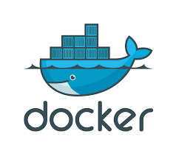




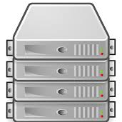

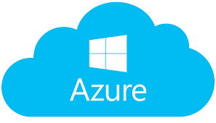

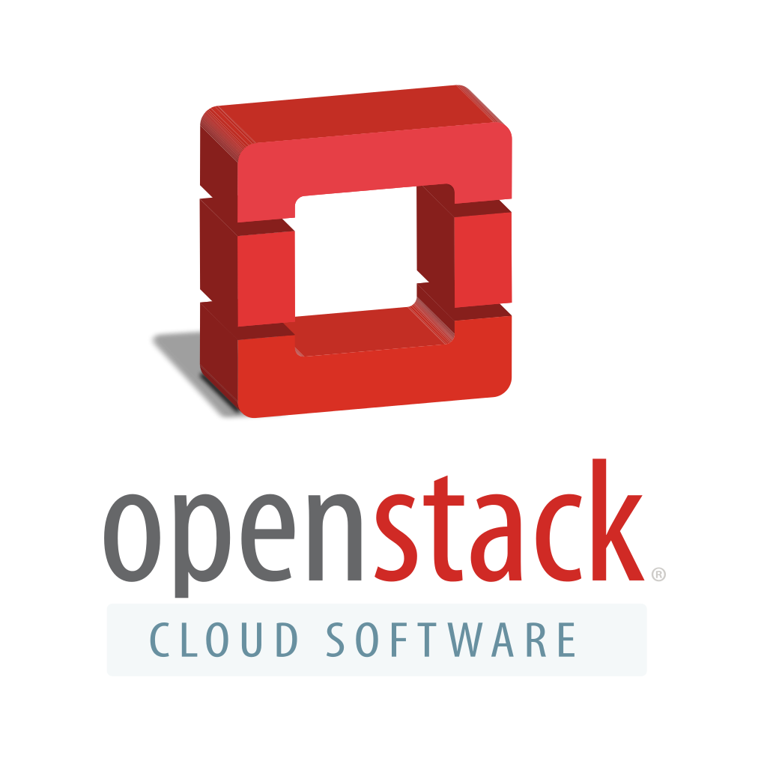

MapR Vision for Operational and Application Agility
Per-tenant Processing & Microservices
Enterprise Apps
Converged App Containers
Shared Data Services
Flexible Hybrid/Multi Cloud Infrastructure
Data Center

Slide 81
MapR Converged Data Platform for Docker
Provides persistent storage with a powerful Docker client for fast access of any data from any node (including nodes outside the MapR cluster)
MapR Converged Data Platform for Docker
Flexible Hybrid/Multi Cloud Infrastructure: Datacenter Servers, Private Cloud, Public Cloud

Slide 82
Challenges with Containers Today

Slide 83
Challenges with Containerizing Existing Applications
Most of the applications that companies are containerizing today are stateless, meaning if they are destroyed and re-deployed no data is lost and no services are disruptive. Example: simple web front-ends.
These applications are stateless because of the challenge of sharing state across many nodes”
Even stateless applications can require persistent storage:
Logs of application history
Configuration
Binary application state
1010101001001 10001000100101101001010100101001010101010101100
Container environments don’t provide the reliable storage needed to support stateful applications

Slide 84

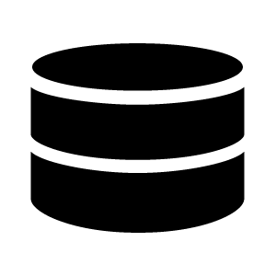
Container Challenges with Microservices
Old
New
Application
Microservice A
Microservice B
Microservice C
Stream
Stream
Applications deployed as single monolith
Single instance of storage, database
Inter-process communication internal to server
Applications are transaction-based
Applications deployed as many microservices
Per-microservice storage, database
Inter-process communication via Streams, REST APIs
Applications are event-based
Microservices Require Data Systems that Scale to Millions of Tables, Streams, Billions of Files

Slide 85
Microservices Require Multi-Dimensional Statefulness
Application “state” can take several forms, all of which need persistence for the application to recover from failure.
Files for configuration, log, and binary state
NoSQL database for operational state
Persistent streams for communication state
Further, the data platform providing state must be reliable, secure, and scalable.
Most companies today trying to build containerized microservices try to deploy point products in containers alongside their applications, which compromises reliability and security.
1010101001001 10001000100101101001010100101001010101010101100
Container environments don’t provide the reliable storage needed to support stateful applications

Slide 86
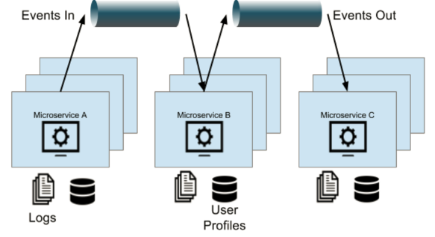

Summary of Containerization Challenges
No Out-of-Box Way to Let Applications Persist State
In case of application or hardware failure, all data written by applications is lost
No Ability to Handle:
Logs, Streams of Application History
Database for Operational State
Streams for Communications between Microservices
?
?
App Container
App Container
1010101001001 10001000100101101001010100101001010101010101100
…
?
?
?
Existing/legacy applications could benefit from containers, but require persistent state.
Newly developed microservices require persistence, but their need is more “converged”.

Slide 87
Existing Workarounds (and Drawbacks)
Workaround #1: Local Storage on Nodes
Drawback: IT must track the files down, and move them when containers are redeployed.
Workaround #2: NAS/SAN Storage
Drawbacks: Not cost-effective. Lots of unnecessary overhead. What if you have thousands of nodes? Connect all to SAN?
Workaround #3: Container-Focused Commercial Offerings
Drawback: Does not solve complexity of data silos. Adds another orchestration layer.
1010101001001 10001000100101101001010100101001010101010101100
End Result: IT Administrators Reject Containerization Due To Operational Complexities.

Slide 88
MapR Solves Container Challenges

Slide 89
MapR Converged Data Platform for Docker
Provides persistent storage with a powerful Docker client for fast access of any data from any node (including nodes outside the MapR cluster)
MapR Converged Data Platform for Docker
Flexible Hybrid/Multi Cloud Infrastructure: Datacenter Servers, Private Cloud, Public Cloud

Slide 90
Demo

Slide 91
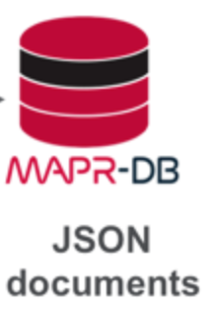
Demo
Local App Development
Access
Local Docker Development
Access
Access
Deployment in Mesosphere

Slide 92
Autonomous cars
Many sensors like
Gyro
Hypersonic
Linetracking
Cameras
And many more

Slide 93
ESP32 microcontroller
from the car + Gyro sensor
WLAN/Bluetooth integrated
240 MHz Dual Core
Power 80 mAh
Price: 5 – 6$
Notes:
Car was to big for plane, so just brought the Microcontroller and Gyro sensor.

Slide 94
MapR-Streams to scale OPC connections

Slide 95
What is OPC?
OPC = OLE for Process Control
Developed in 1996
Industry standard
Specifies the communication of real-time plant data between control devices from different manufacturers
OPC foundation maintains the standard
Two kinds of protocol
OPC classic
OPC UA (Unified Architecture)

Slide 96
OPC dataset contains
Item name
Timestamp
Quality of measurement
Error code
Value type
Measured value
String
Numbers (Double, Float, DWord, Long, Int, etc)
Arrays with primitive types

Slide 97
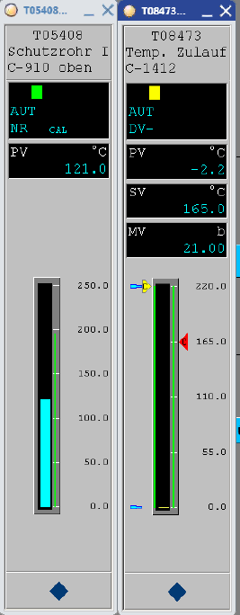
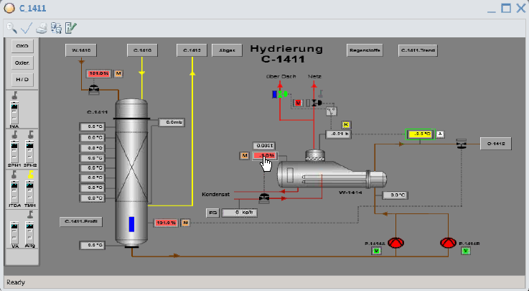
YOKOGAWA Dashboard

Slide 98
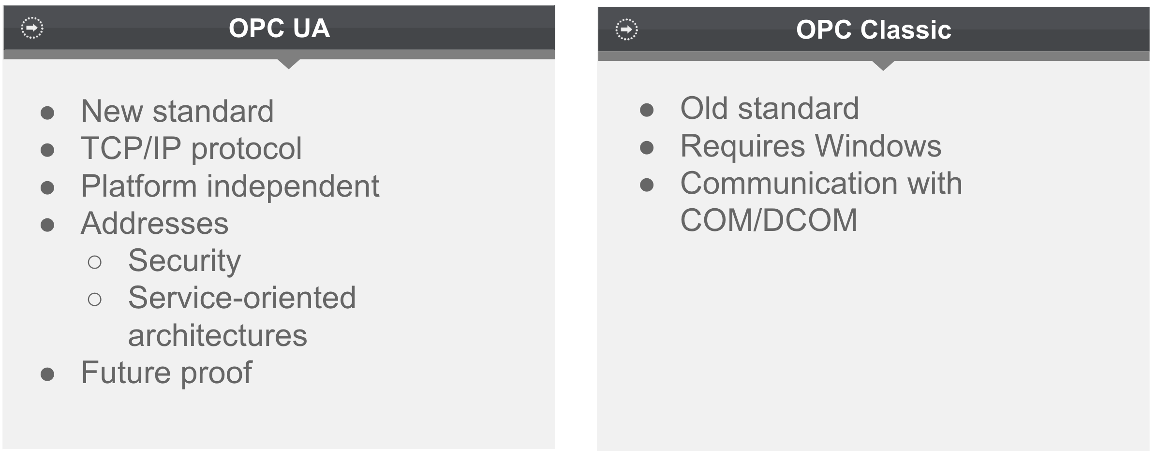
OPC protocols

Slide 99




Classic approach with OPC servers
Choose two*.
Large amount of sensors
OPC Server
* Many OPC servers does not scale well.
Many consumers
Low fetch interval

Slide 100

Your system does not scale!

Slide 101

MapR’s approach with OPC servers
Large amount of sensors
We can have it all!
MapR-Streams for scaling up the number of consumers.
OPC Server
Many consumers
Low fetch interval

Slide 102
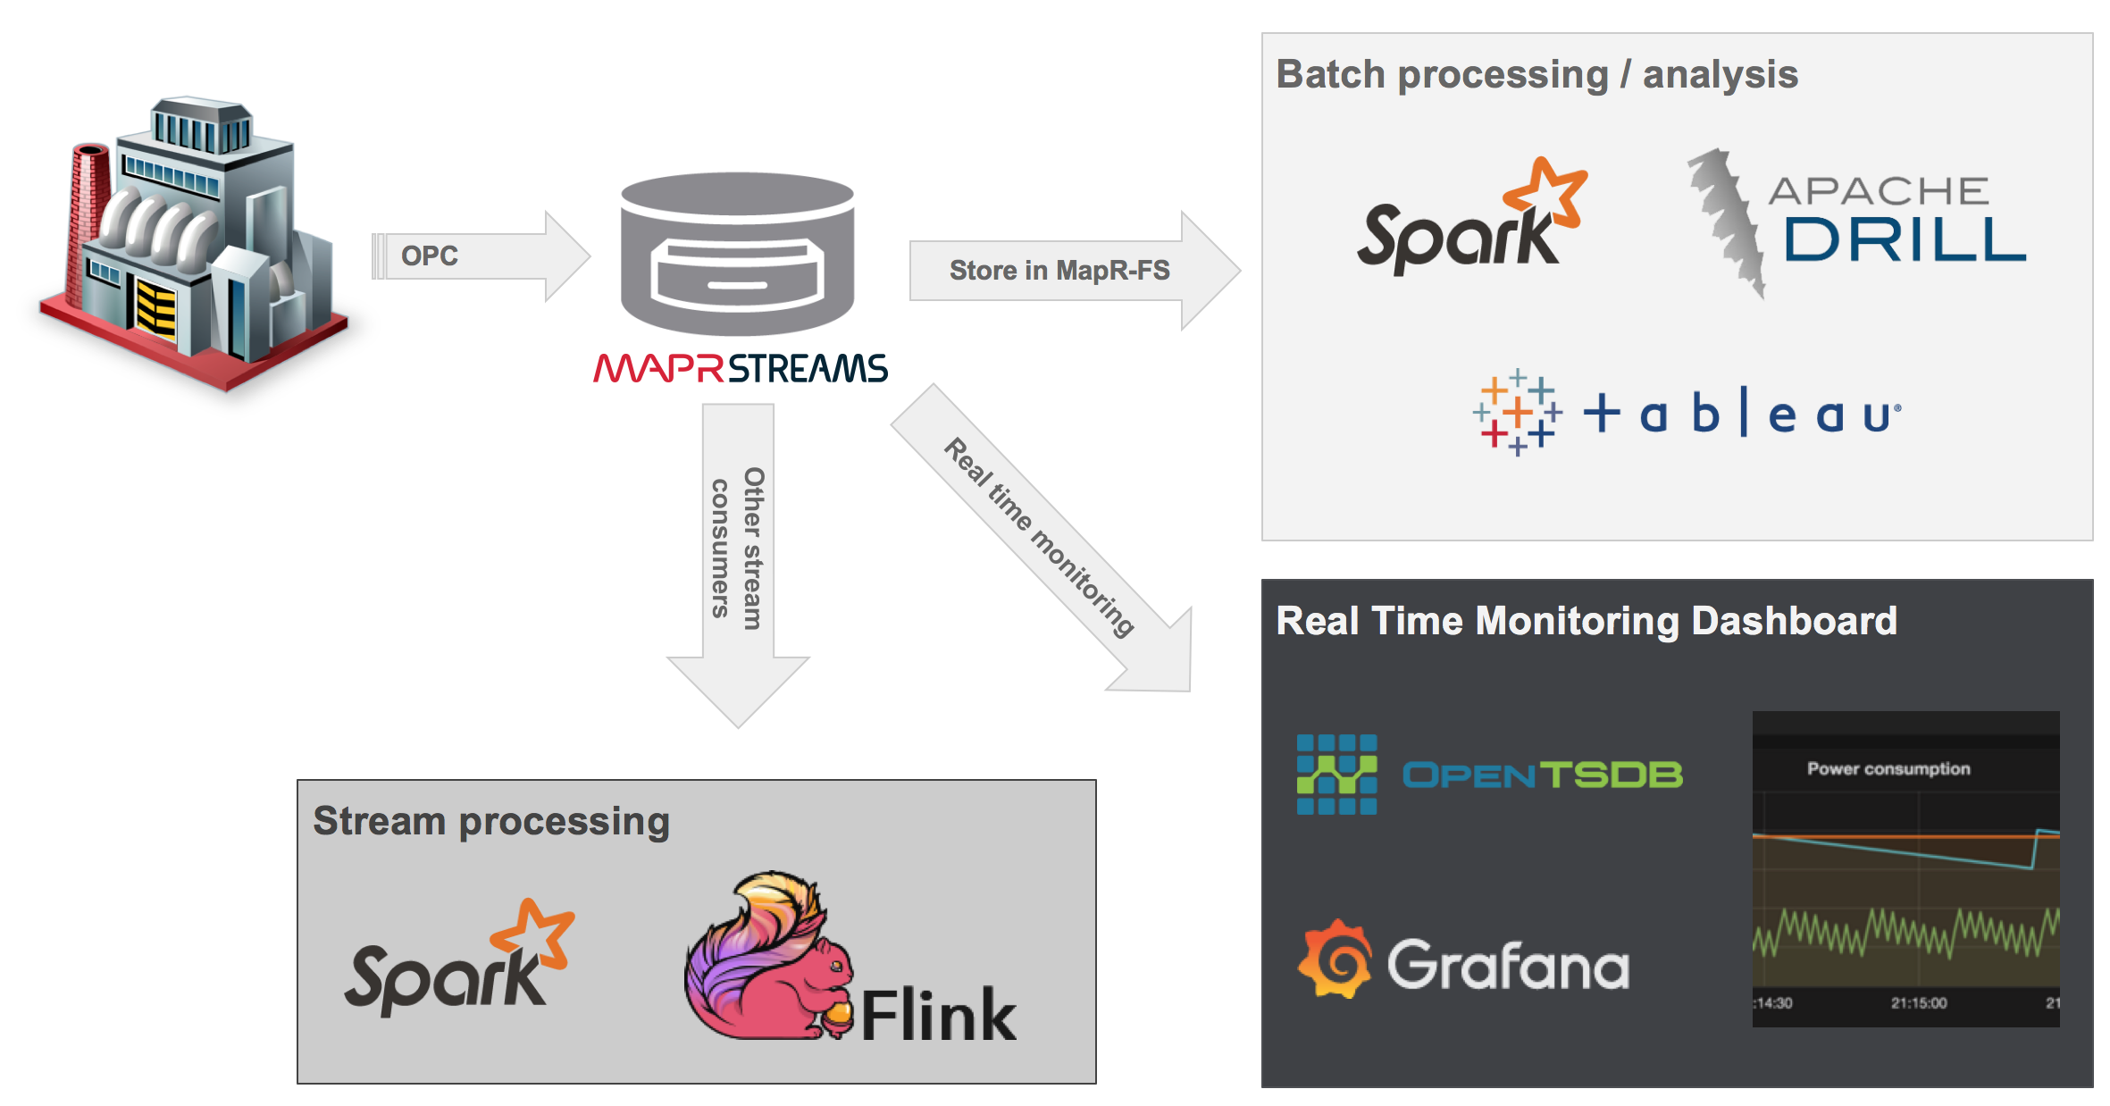

Slide 103
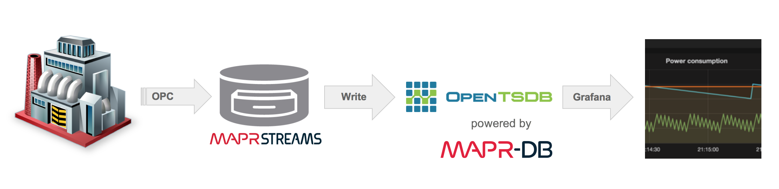
Real-time visualisation example
Fetch sensoric data from OPC server
Ingest to MapR-Streams
Consume from Streams and write into OpenTSDB
Visualize with Grafana

Slide 104
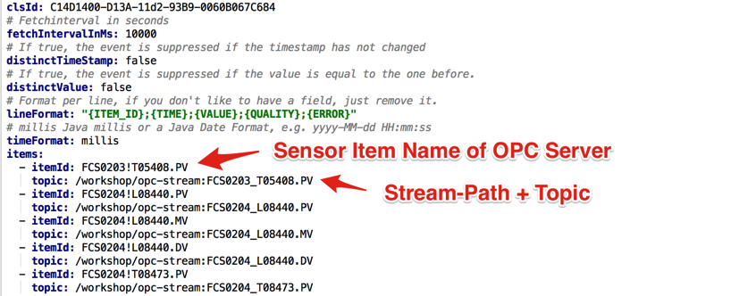
Example of OPC and MapR-Streams configuration

Slide 105
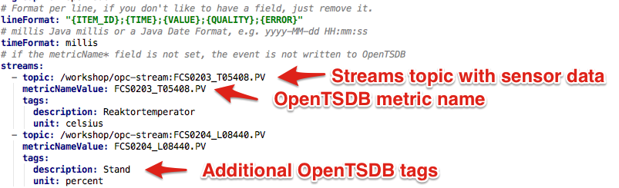
Consume stream and write to OpenTSDB

Slide 106
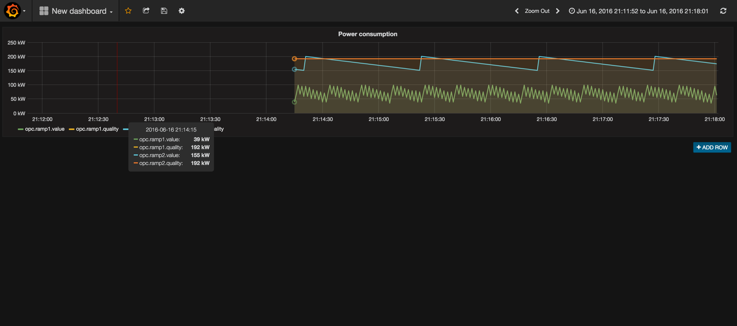
Visualized in Grafana

Slide 107
MAPR EDGE FOR IoT ARCHITECTURES

Slide 108
IOT Fundamental Questions
I am collecting sensor data, but what do I do with it?
How do I act?
How do I build intelligence?
Do I keep the data?
Where do I collect, How much should I collect ?
Does Security have a role ?

Slide 109
Multi Dimension face of IOT
IOT
System
Locality
Analytics
Conditioned
Cognizant
Deep
Local
Edge
Cloud
Enterprise
Sensors
Sensors & Systems
System of Systems
Information & Comm Tech
Cross-domain data driven applications
Data integration
Big data analytics
Multitenant data aggregation and provisioning
SMART USER
Ubiquitous info for sustainable decisions
Smart & privacy-aware applications
Integration in urban environment

Slide 110
Challenges

Slide 111
IOT Challenges
Device Management
Legacy products
Authorization and identification
Data & Data collection rate from Devices
Data format
Limited due to constraints ( Power, bandwidth, storage)
Manage the Physical & Digital representation
Digital twin
Data Quality and Data Management
Application Architecture

Slide 112













DEVICES
0
0
0
1
0
0
0
1
0
0
0
0
1
0
0
0
1
0
0
0
0
1
0
0
0
1
0
0
0
0
1
0
0
0
1
0
0
0
0
1
0
0
0
1
0
0
0
0
1
0
0
0
1
0
0
0
0
1
0
0
0
1
0
0
0
0
1
0
0
0
1
0
0
0
0
1
0
0
0
1
0
1
0
1
0
0
0
1
0
1
0
0
1
1
0
1
0
1
0
0
0
1
0
1
0
1
0
0
0
1
0
1
1
0
1
0
1
0
0
0
1
0
0
0
1
0
0
0
0
1
0
0
0
1
0
1
0
1
0
0
0
1
0
0
0
0
1
0
0
0
1
0
0
0
0
1
0
0
0
1
0
0
0
0
1
0
0
0
1
0
0
0
0
1
0
0
0
1
0
0
0
0
1
0
0
0
1
0
0
0
0
1
0
0
0
1
0
0
0
0
1
0
0
0
1
0
0
0
0
1
0
0
0
1
0
0
0
0
1
0
0
0
1
0
0
0
0
1
0
0
0
1
0
0
0
0
1
0
0
0
1
0
1
0
1
0
0
0
1
0
1
0
0
1
1
0
0
0
0
1
0
0
0
1
0
0
1
0
1
0
1
1
0
1
0
0
0
1
0
0
0
0
1
0
0
0
1
0
1
0
1
0
0
0
1
0
1
0
0
1
1
0
1
0
1
0
0
0
1
0
1
0
1
0
0
0
1
0
1
0
0
1
1
0
1
0
1
0
0
0
1
0
1
0
1
0
0
0
1
0
0
0
0
1
0
0
0
1
0
1
0
0
1
1
0
1
0
1
0
0
0
1
0
0
0
0
1
0
0
0
1
0
0
0
0
1
0
0
0
1
0
1
0
1
0
0
0
1
0
1
0
0
1
1
0
1
0
1
0
0
0
1
0
1
0
1
0
0
0
1
0
1
0
0
1
1
0
1
0
1
0
0
0
1
0
1
0
1
0
0
0
1
0
1
0
1
0
0
0
1
0
1
0
1
0
0
0
1
0
1
0
0
1
1
0
1
0
1
0
0
0
1
0
0
0
0
1
0
0
0
1
0
0
0
0
1
0
0
0
1
0
1
0
0
1
1
0
1
0
1
0
0
0
1
0
1
0
1
0
0
0
1
0
1
0
0
1
1
0
1
0
1
0
0
0
1
0
1
0
1
0
0
0
1
0
1
0
0
1
1
0
1
0
1
0
0
0
1
0
1
0
1
0
0
0
1
0
1
0
1
0
0
0
1
0
1
0
0
1
10
1
0
0
1
1
0
1
0
1
0
0
0
1
0
0
0
0
1
0
0
0
1
0
1
0
1
0
0
0
1
0
1
0
0
1
1
0
1
0
1
0
0
0
1
0
1
0
1
0
0
0
1
0
1
0
0
1
1
0
1
0
1
0
0
0
1
0
1
0
1
0
0
0
1
0
1
0
0
1
1
0
1
0
1
0
0
0
1
0
1
0
1
0
0
0
1
0
1
0
0
1
1
0
1
0
1
0
0
0
1
0
1
0
1
0
0
0
1
0
1
0
1
0
0
0
1
0
1
1
0
1
0
1
1
0
1
0
0
0
1
0
1
0
1
0
0
0
1
0
1
0
0
1
1
0
1
0
1
0
0
0
1
0
1
0
1
0
0
0
1
0
1
0
0
1
1
0
1
0
1
0
0
0
1
0
1
0
1
0
0
0
1
0
1
0
0
1
1
0
1
0
1
0
0
0
1
0
1
0
1
0
0
0
1
0
1
0
0
1
1
0
1
0
1
0
0
0
1
0
1
0
1
0
0
0
1
0
1
0
0
1
1
0
1
0
1
0
0
0
1
0
1
0
1
0
0
0
1
0
1
0
0
1
1
0
1
0
1
0
0
0
1
0
1
0
1
0
0
0
1
0
1
0
0
1
1
0
1
0
1
0
0
0
1
0
1
0
1
0
0
0
1
0
1
0
0
1
1
0
1
0
1
0
0
0
1
0
1
0
1
0
0
0
1
0
1
0
0
1
1
0
1
0
1
0
0
0
1
0
1
0
1
0
0
0
1
0
1
1
0
1
0
1
1
0
1
0
0
0
1
0
1
0
1
0
0
0
1
0
1
0
0
1
1
0
0
0
0
1
0
0
0
1
0
0
0
0
1
0
0
0
1
1
0
1
0
0
0
1
0
0
0
0
1
0
0
0
1
0
1
0
1
0
0
0
1
0
1
0
0
1
1
1
0
1
0
0
0
0
1
0
1
0
0
0
1
0
1
1
0
1
0
1
1
0
1
0
0
0
1
0
1
0
1
0
0
0
1
0
1
0
0
1
1
0
1
0
1
0
0
0
1
0
Chip/Device
1
0
1
0
0
0
1
0
0
0
0
1
0
0
0
1
0
1
0
1
0
0
0
1
0
1
0
0
1
0
0
0
0
1
0
0
0
0
0
0
1
0
1
0
0
0
0
1
0
0
0
1
0
1
0
0
1
1
0
1
0
0
0
1
0
1
0
0
0
0
0
1
0
0
0
0
1
0
0
0
1
0
1
0
0
1
1
0
1
0
0
0
0
0
1
0
1
0
0
1
1
0
1
0
1
0
0
0
1
0
1
0
0
0
1
0
1
0
0
0
1
0
0
0
1
0
1
0
0
0
1
0
0
0
1
0
1
0
1
0
0
0
1
0
1
0
0
0
1
0
0
1
1
0
1
0
0
0
1
0
1
0
0
0
1
0
1
0
0
0
1
0
1
0
0
0
1
0
0
1
1
0
1
0
1
0
0
0
0
0
1
0
1
0
1
0
0
0
1
0
0
0
1
0
1
0
1
0
0
0
1
0
1
0
0
0
1
0
0
0
1
00
Edge
1
0
1
0
0
00
DISTRIBUTED PROCESSING (DEVICE, EDGE, CLOUD, ON PREMISES)
Location driven by
Data gravity
Safe harbor
Costs
Resource availability
1
0
0
1
1
0
1
0
0
1
1
0
1
0
0
1
1
0
0
0
0
1
0
0
0
1
0
1
1
0
1
0
1
0
1
1
1
1
0
1
0
1
0
1
1
1
1
0
1
0
1
0
1
1
1
1
0
1
0
1
0
1
1
1
1
0
1
0
1
0
1
1
1
1
0
1
0
1
0
1
1
1
1
0
1
0
1
0
1
1
Analytics
Skills
Integration
Public
Private
On Premise
Notes:
If you look across the entirety of things, it’s quite diverse. RFID sensors on merchandise, livestock, small equipment parts. Consumer devices such as refrigerators, thermostats, and wearables. Transportation assets like planes, cars, trains, container ships. Industrial equipment, medical devices, etc.
And with all of these distributed sources of data, location of your computing resources becomes top of mind. Issues like data gravity will drive your architecture, in which critical masses of data creates more “gravity” that attracts more data, users, and applications, and that promotes further growth. Working with data gravity, as well as working against it, will both be required.
“Safe harbor” requirements mean that you need to ensure data resides within certain environments as specified by regulations. This mostly has to do with privacy, so having a location-aware architecture will be critical for compliance purposes.
Costs and resource availability are intertwined, as you want to optimize your costs while ensuring you have the right hardware and human resources to address your requirements.
Another architectural decision pertains to the difference between the two main classes of IoT. For the consumer IoT world, scale becomes critical because of the sheer number of devices. Each device may not create much data in isolation, but it’s the aggregation of all the device data that results in high volume. Contrast that to industrial IoT environments where the new challenge is that each device will create a tremendous amount of data.

Slide 113








KEY TO REAL-TIME AT SCALE: GLOBAL PROCESSING
Distributed processing across clusters, data centers and public and private cloud environments
Flexible processing where change is the norm
Supports global apps that can scale arbitrarily
Notes:
“Real-Time” and “Scale” are two critical requirements in data-driven companies today. You need to act quickly, and you need a lot of data to get the insights that will give your organization an advantage.
To leverage real-time at scale, you need to take advantage of all resources across many regions. Decisions about deployments today are not about on-premises versus cloud; the decisions now focus on how to best take advantage of the range of on-premises, hybrid cloud, and intercloud options. This range gives you the flexibility and agility you need when managing big data. You can quickly deploy global apps that scale arbitrarily when leveraging a globally distributed network of resources.

Slide 114

EXAMPLE: CONNECTED CAR
HIGH FREQUENCY DECISIONING USE CASES
Advanced Driver Assistance Systems (ADAS)
Computer Aided Driving
Vehicle Healthcare
Fleet Management
By 2020, more than 250 million vehicles will be connected globally
- Gartner
Notes:
An excellent example of the industrial IoT is the connected car story. Computing power in cars has increased 10M times since 1990 levels (faster than Moore's Law). By 2020 more than 250M vehicles will be connected globally.
With connected car there is not a single application but many that span across the entire vehicle lifecycle.

Slide 115




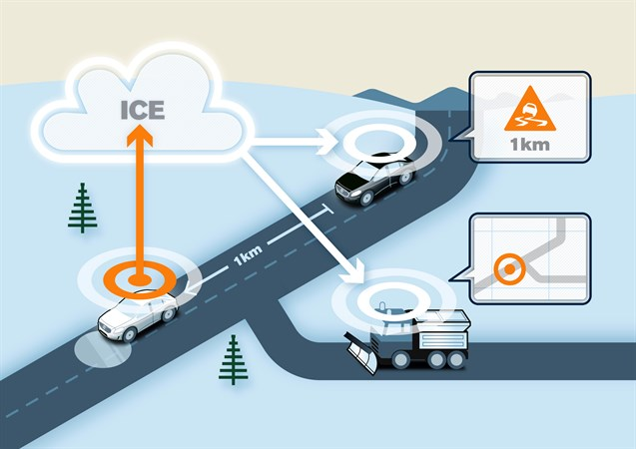

Systems of systems via digital integration
Alert road maintenance
Slippery Road
Contractor fulfillment
Road investments
Deep
Cognizant
Conditioned

Slide 116
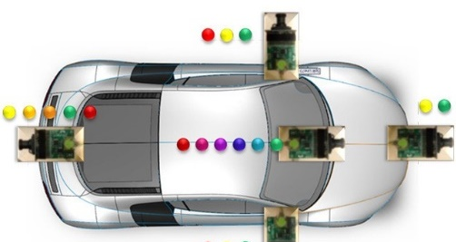

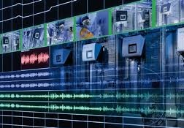


AUTOMOTIVE IOT EXAMPLES
ADVANCED DRIVER ASSISTANCE SYSTEMS (ADAS)
COMPUTER AIDED DRIVING
VEHICLE HEALTHCARE
INSURANCE AND FINANCIAL SERVICES
Lane change
Traffic sign recognition
Pedestrian recognition
Collision avoidance
Automatic parking
Detecting traffic jams
Road condition warnings
Dynamic maps
Exhaust monitoring
Engine function
Predictive maintenance
Accident/breakdown management
Pay as you drive
Pay how you drive
Pay where you drive
Fleet Management
Delivery services
Utilities/Trucking companies
Notes:
Connected car applications range from on-board applications that integrate data as part of advanced driver assistance systems, to computer aided driving apps that incorporate local data to detect traffic and road conditions.
Data on a regional and global basis drives vehicle health applications including predictive maintenance and accident prevention.
Driving and vehicle data are also being used for new insurance and financial services applications.

Slide 117
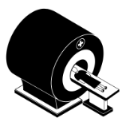










MEDICAL DEVICE COMPANY CASE STUDY
Manual processes, scripts, file sync
Anonymization prior to delivery to core cluster
Thousands of medical machines in each hospital
Automated process
MapR Core Cluster
MapR Core Cluster
Source
1
Source
1
Source
1
Source
2
Internet
Source
2
Internet
Source
2
Source
100
Machine learning diagnosis app
Source
100
Machine learning diagnosis app
Source
1000
Time to insight (12 hrs)
Time to insight (< 15 mins)
Before MapR Edge
With MapR Edge
Notes:
One of our medical device customers have space constraints for edge clusters, so MapR Edge running on mini PCs works well. For some analysis, like on MRI scans, they need significant computing power so they have to deliver the data through manual means to a core cluster that does the analysis.
With MapR, they can anonymize any data, send it over the Internet to the core cluster to do large-scale processing, and then return the results immediately. They not only get quick turnaround, but they can also store the private data at the medical center versus having it stored at the home cluster.

Slide 118
MapR Edge

Slide 119
Analytics and locality
Conditioned
Real time
Minimal time to perform computing
Cognizant
Near real time (sec to min)
More time for computation
Computation mainly on data from devices
Deep
Non-real time
More time for computation
Computation on more data sets
Local
Edge
Cloud
Enterprise
“directly wired”
local with some computation resources
remote with scalable computation resources and access to some other data
Scalable computation resources and access to other data

Slide 120


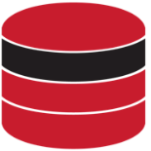






MAPR EDGE FOR INTERNET-OF-THINGS
GLOBAL DATA PLANE
Computing power close to the data
Aggregate, analyze data at core
MAPR CONVERGED DATA PLATFORM
[on-prem, hybrid, cloud]
Small footprint at the edge
Send insights back to edge
MAPR EDGE
MAPR EDGE
Reliable replication
Convergence at the edge
MAPR EDGE
Notes:
With these industrial IoT devices that can create terabytes of data in short time windows, a new architecture is required. While the MapR Converged Data Platform has always been good for the consumer IoT model, the industrial IoT model now has an optimal approach with MapR Edge.
MapR Edge is the full-featured MapR Converged Data Platform optimized to run on small-footprint, commodity hardware. MapR Edge is the result of ongoing engineering work to get the MapR Platform to run reliably on nodes with limited RAM, as demonstrated in our MapR Sandbox, a virtual machine that runs MapR with a small amount of memory.
MapR Edge puts computing power close to the data to enable processing in real-time. It works in conjunction with a core MapR deployment so you can perform local processing while also taking advantage of a larger, centralized cluster of aggregated data.

Slide 121
“ACT LOCALLY, LEARN GLOBALLY” WITH MAPR EDGE
Act Locally, Learn Globally” IoT applications leverage local data from numerous sources for constructing machine learning or deep learning models with global knowledge. These models are then rapidly deployed to the edge to enable real-time decisions based on local events.
Notes:
We describe the interaction of MapR Edge clusters with a centralized core cluster as “act locally, learn globally.” This architecture gives you processing power to immediately act on events close to the data source, while also delivering the data, or subsets of it, to the central cluster to gain globally-based insights on aggregated data. These insights, in the form of machine learning models, are then deployed to the edge clusters for more real-time processing. This architecture is just another way that MapR lets you operationalize your data.

Slide 122
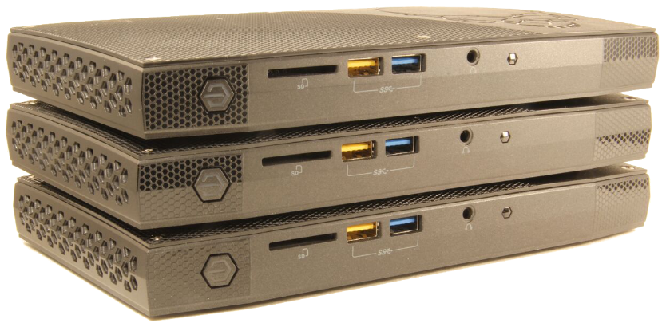
MAPR SOLVES BIG DATA AT THE EDGE
DESIGNED FOR EDGE LOCATIONS
Data sources that create huge volumes of data
E.g., oil rigs, cell towers, hospitals, vehicles, remote offices, etc.
Sites with slow or occasionally connected network access
INTEL NUC MINI PCS
(8.3” X 4.6” X 1.1”)
Space constrained locations requiring small footprints
• 3-5 node cluster, storage capacity limits, minimum 16GB RAM
• Optimized for mini PCs (e.g., Intel NUCs)
Notes:
MapR Edge is ideal for dealing with the characteristics of edge locations in industrial IoT environments. Data sources that create huge volumes of data such as oil rigs and vehicles are ideal environments for MapR Edge. Slow or occasionally connected sites can be managed by the bandwidth-aware replication in MapR. Space constrained locations that require a small computing footprint can be handled by MapR Edge, as it runs as a 3 to 5 node cluster on mini PCs such as the Intel NUCs, which are typically the size of a small book and can be bought off the shelf. Other vendors make similar PCs that are hardened for remote and even harsh locations as part of an IoT deployment.

Slide 123
EXTEND THE POWER OF THE MAPR PLATFORM
MapR Edge supports:
Access to files, tables, documents, streams
Multiple compute engines – Spark, Drill, Hive, etc.
Data management capabilities such as volumes, quotas, compression, MapR Control System
Business continuity via replication, mirroring, and snapshots
Data distribution via global, bandwidth-aware, incremental replication capabilities
Notes:
MapR Edge gives you the full power of the MapR Platform. It provides full access to the various storage engines and data formats supported by MapR.
It lets you run Spark, Drill, Hive, and any other supported compute engine.
It has the full data management capabilities in MapR including features such as volumes, quotas, and compression.
Business continuity is supported with replication, mirroring, and snapshots.
And data distribution, especially to the central analytics cluster, is managed by the bandwidth-aware replication system.

Slide 124
MAPR EDGE KEY FEATURES AND BENEFITS
Distributed data aggregation
• Reduce bandwidth requirements
• Maintain data privacy
• Comply with data location regulations
• Reliably consolidate data from edge sites
• Minimize space requirements
Bandwidth-awareness
• Transport data reliably even in slow or occasional connections
Global data plane
• Simplify development/deployment with a global view of all data in a single namespace
Notes:
Some of the key features and benefits include the following:
With distributed data aggregation, you can:
Reduce bandwidth requirements to the core cluster by sampling/summarizing/transforming edge data.
Maintain privacy by anonymizing edge data prior to delivery to the core cluster.
Comply with data location regulations by storing personally identifiable information (PII) locally.
Reliably consolidate data from edge sites to the core cluster.
Minimize space requirements with the small hardware footprint.
Bandwidth-awareness lets you transport data reliably to the core cluster even in slow or occasionally-connected environments.
The global data plane lets you simplify development and deployment with a global view of all distributed clusters in a single namespace.

Slide 125
MAPR EDGE KEY FEATURES AND BENEFITS (CONT.)
Converged analytics
• Gain faster time-to-insight at the edge.
Unified security
• Protect data stored at the edge as well as in motion
• Reduce complexity with a consistent security framework
Standards-based
• Simplify code development standard-based interfaces
Enterprise-grade reliability
• Reduce costly downtime
Notes:
With converged analytics, you can gain faster time-to-insight with high speed processing power and analytics capabilities at the edge.
Unified security lets you:
Protect data with strong security controls on data stored at the edge (via authentication/authorization/access controls) as well as on data in motion (i.e., over-the-wire encryption).
Reduce complexity with a consistent security framework from edge to core.
MapR Edge is standards-based which simplifies code development with POSIX and the HDFS API for file access, ANSI SQL for querying, the Kafka API for event streams, and the HBase and OJAI APIs for NoSQL database.
And it provides enterprise-grade reliability to reduce costly downtime by tolerating multiple hardware failures in remote, isolated deployments.

Slide 126
Three Key “Agilities” Drive Our Priorities
Data Agility
Unified Files, Tables, Streams
Support for schemas that change
Multi-modal support in a DBMS
Application Agility
Microservices support
No-copy access to Files, Streams, DB
Multiple compute engines + key ecosystem components
Consistent security model
Files
Database
Event Streaming
High Availability
Real Time
Unified Security
Multi-tenancy
Disaster Recovery
Global Namespace
Infrastructure Agility
Multi-dimensional elasticity
Global multi-cloud
Container apps with data persistence

Slide 127
MapR Converged Data Platform
Speed, Scale, Reliability
Supports Open APIs
Shared Services
Files, Tables, Streams
together on same platform
Web-Scale Storage
MapR-FS
Database MapR-DB
Event Streaming MapR Streams
High Availability
Real Time
Unified Security
Multi-tenancy
Disaster Recovery
Global Namespace
On-Premise, In the Cloud, Hybrid

Slide 128
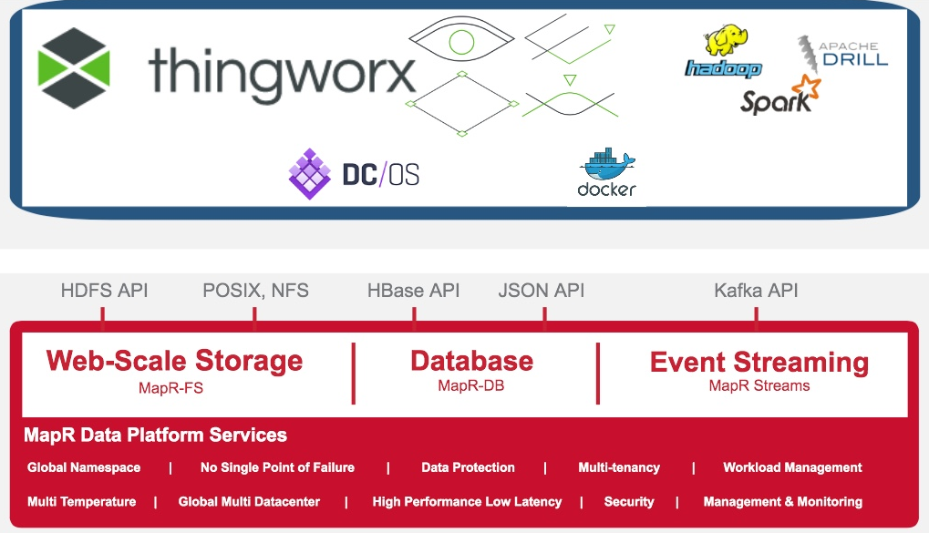
ThingWorx & MapR in Action
Application Enabled Micro Services
Converged Data Services

Slide 129
IOT Summary
IoT is local and global
IoT is sensors and actuators
Some IoT is real-time, and some is not
Analytics provide intelligence at all levels
Not all data may need to be stored, but process it for insights
Security is important

Slide 130




ENGAGE WITH US
Q&A
@mapr
chufe@mapr.com

Slide 131
TRANSITION SLIDE OPTION 1

Slide 132
TRANSITION SLIDE OPTION 2

Slide 133
TITLE WITH CONTENT AND BYLINE
SUBHEAD
Sub point
Sub point
Sub point
Sub point

Slide 134
OBJECT SHAPES
Shapes should be rectangular, filled with a solid color, consistent in size, touching each other, and separated with a white line.
Emphasis may be placed on one block by using a differentiating color

Slide 135
“MapR gives me the reliability to keep our online service up and running 24x7x365.”
—CTO, International Government Program (Aadhaar)

Slide 136
2 ITEMS
PROFESSIONAL SERVICES
SYSTEM INTEGRATORS
Text Here
Text Here

Slide 137
SAMPLE FOR 4 ITEMS (OR 3) WITH A LOT OF TEXT
ALL INDUSTRIES
WEB 2.0
HEALTHCARE
TELCO
Multi-structured data staging & archive
ETL/DW optimization
Mainframe optimization
Data exploration
Recommendation engines & targeting
Customer 360
Click-stream analysis
Social media analysis
Ad optimization
Network security monitoring
Security information & event management
Fraudulent behavioral analysis
Supply chain & logistics
System log analysis
Manufacturing quality assurance
Preventative maintenance
Smart meter analysis

Slide 138
WHEN YOU HAVE 4 ITEMS (OR 3) WITH LITTLE TEXT
Sample Text
Sample Text
Sample Text

Slide 139






























CUSTOMER LIST
FINANCIAL SERVICES
RETAIL & CPG
SECURITY
ONLINE SERVICES & SOFTWARE
MEDIA & ENTERTAINMENT
MARKET RESEARCH
ADVERTISING
HEALTH
COMMUNICATIONS
GOVERNMENT

Slide 140
ICONS

Slide 141












ICONS ON WHITE/GRAY
Healthcare
Insurance
Energy
Database
Unified Security
Multi-tenancy
Search
Pro Services
Converged App
Documentation
Training
TCO Calculator

Slide 142










ICONS ON WHITE/GRAY
Release Number
Sandbox
Tech Docs
MCDP
News
Multi-tenancy 2
Get Started
Events
Converge
Case Studies
Blogs

Slide 143












ICONS ON BLACK
Healthcare
Insurance
Energy
Database
Unified Security
Multi-tenancy
Search
Pro Services
Converged App
Documentation
Training
TCO Calculator

Slide 144











ICONS ON BLACK
Release Number
Sandbox
Tech Docs
MCDP Reverse
News
Multi-tenancy 2
Get Started
Events
Converge
Case Studies
Blogs

Slide 145







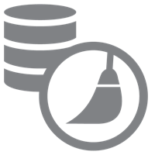


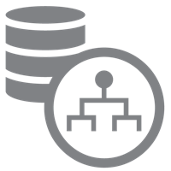












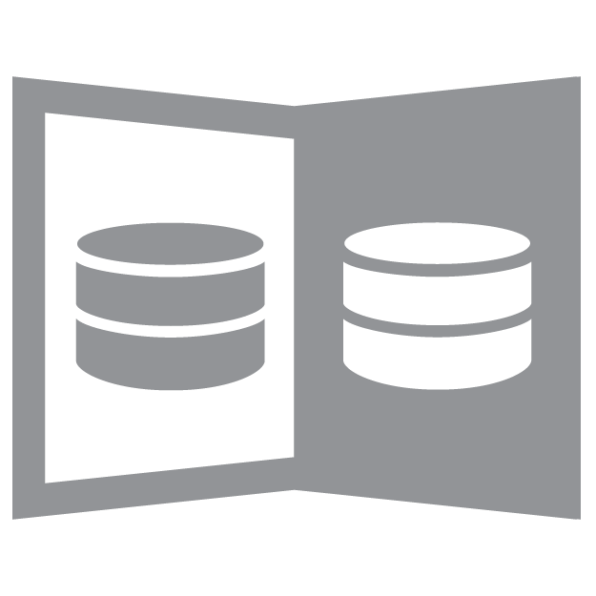


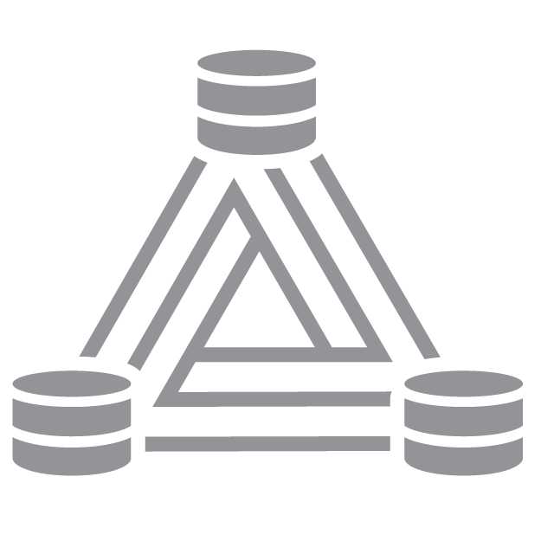








SECONDARY ICONS–FEATURES
24x7 Apps
Administration
Applications
Authentication
Authorization
Backup Recovery
Control System
Data Cleansing
Data Governance
Data Integration
Data Lineage
Data Protection
Disaster Recovery
Easy Access
Easy Management
Encryption
Enterprise Grade
High Availability
Integration
Interoperability
Job Tracker
Jobs
Lower Cost
Mirroring
Multi Tenancy
Performance
Replication
Rolling Upgrades
Scalability
Search
Security
Self Healing
Simplified Workflows
Snapshots
Streaming

Slide 146










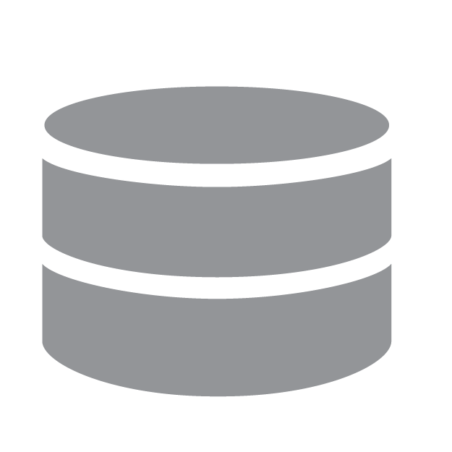

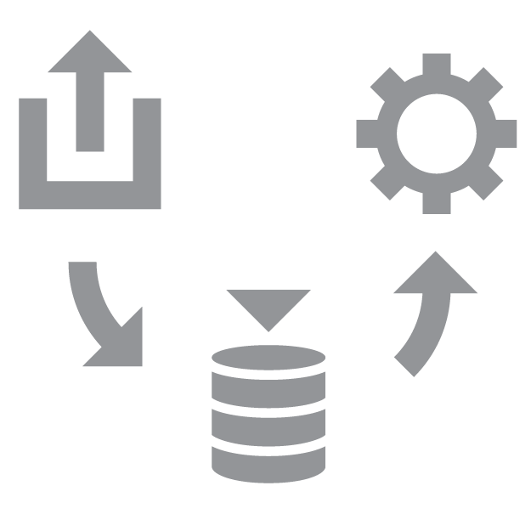

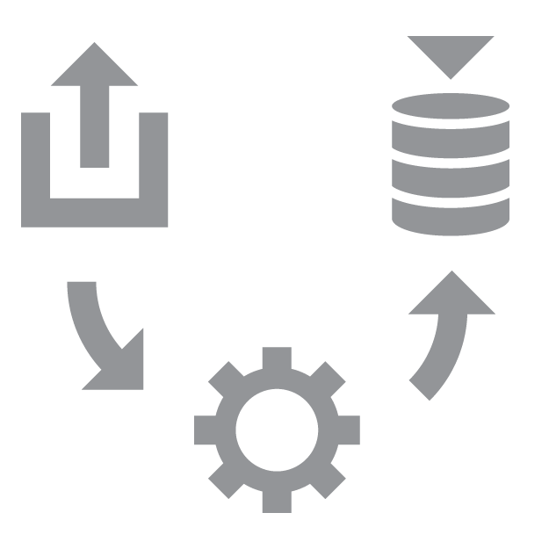


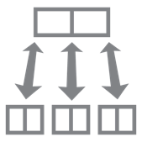














SECONDARY ICONS–BIG DATA
Access
Analytics
Architecture
Batch
Big Data
Business Intelligence
Cloud
Data Center
Data Mart
Data Warehouse
Database
Disk
ELT
Enterprise Data Hub
ETL
File System
Ingest
MapReduce
Network
NoSQL
Offload
On Premises
Open Source
Operational Analytics
Production Success
Rack
Real Time
Servers
SQL
Storage
Storage Layer
Virtualization

Slide 147







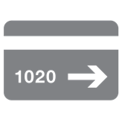






















SECONDARY ICONS–DATA SOURCES
Audio
Billing Data
Call Detail Records
Clickstream
CSV
Data
Documents
Emails
Information
JSON
Medical Records
Merchant Listings
Meta Data
Microsoft Office
Mobile Data
Network Data
PDF
Product Catalog
Sensor Data
Server Logs
Set Top Box
Social Media
Text Files
Text Messages
Video
XML
Report
Smart Phone
Tablet
Monitor

Slide 148





























SECONDARY ICONS–INDUSTRY
Advertising
Education
Financial Services
Government
Government Civilian
Government Defense
Government Intelligence
Government State/ Local
Healthcare
Information Technology
Insurance
Internet
Manufacturing
Media
Natural Resources
Pharmaceuticals
Retail
Telecommunications
Finance
Transportation
Utilities
oil
Manufacturing
Internet
Shipping
Healthcare
IoT
Compute

Slide 149















SECONDARY ICONS–USE CASES
Graph Analysis
Analytics
Anomaly Detection
Classification Clustering
Customer 360
Data Hub
Data Mining
Fraud Detection
Interactive Marker
Marketing
Personalized Offers
Recommendation Engine
Risk Management
Search
Telemetry

Slide 150





SECONDARY ICONS–END USERS
Business Analyst
Data Scientist
Developer
Executive
IT Administrator

Slide 151
ENGAGE WITH US
Q&A
@mapr
dalekim@mapr.com

